Slide 1
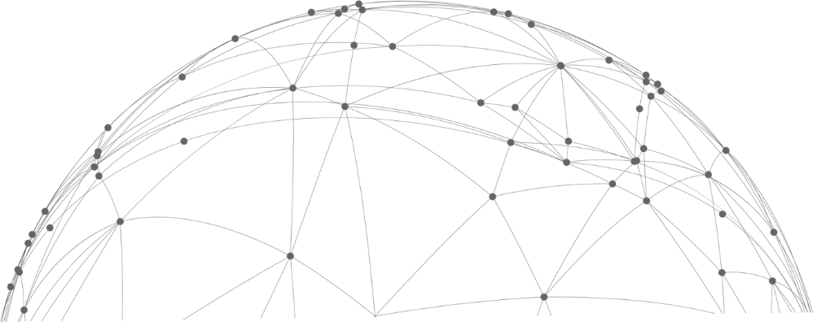
Detection of Driver Distracted Behavior and Drowsy Driving
Group 15
杨皓言 1930026145
覃逾鳌 1930026111
杨其润 1930026146

Slide 2
Content
Part 01 / Introduction
Part 02 / Detection of Distracted Behavior
Part 03 / Detection of Drowsy Driving
Part 04 / Conclusion

Slide 3
Part 01
Introduction

Slide 4
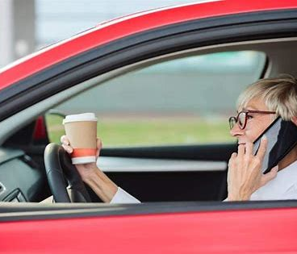
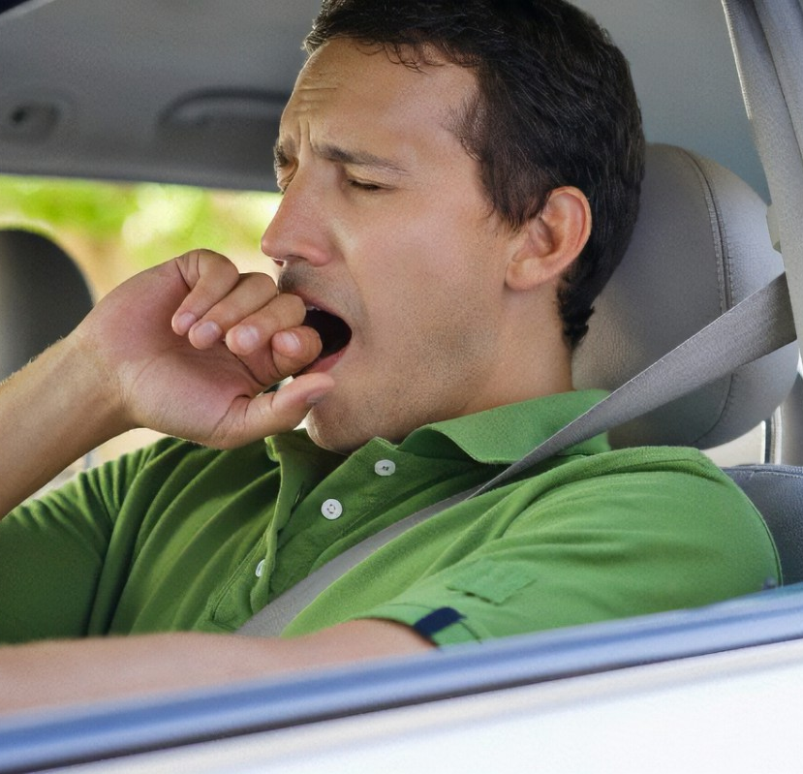
Background
1. In reality, the behaviors that lead to distracted driving include using phones, drinking. And traffic accidents caused by distracted driving are common. A glance at a phone is equivalent to about 50 meters of "blind driving" of a car.
2. Another major factor in driving accidents comes from drowsy driving. According to statistics, traffic accidents caused by drowsy driving account for 21% in China, and the fatality rate is as high as 83%.

Slide 5
Purpose
In order to reduce accidents caused by distracted behavior and drowsy driving, our project is to establish models to identify these two aspects of behaviors accurately. When the situations are detected, we can remind the driver to reduce the occurrence of accidents.

Slide 6
Part 02
Detection of Distracted Behavior

Slide 7
Dataset
Our dataset collects 8 states of drivers while driving, including safe driving and 7 different distraction behaviors, for a total of more than 20,000 images.

Slide 8
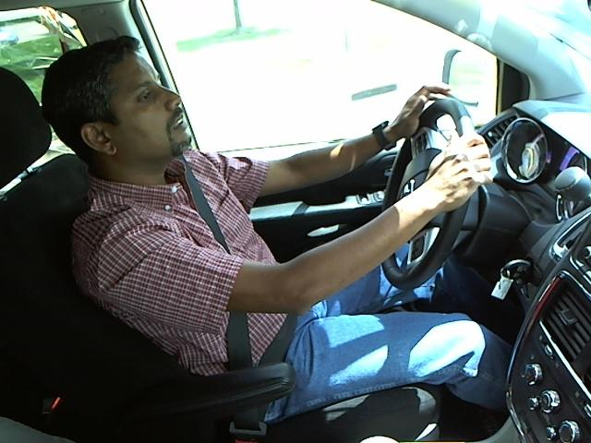
C0 Safe Driving

Slide 9
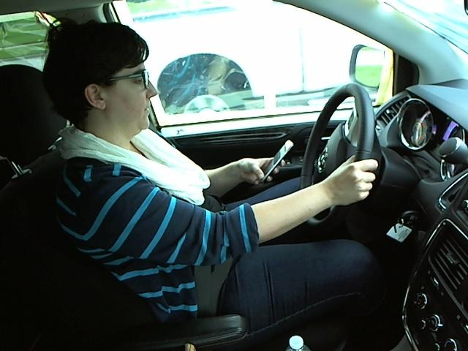
C1
Texting

Slide 10
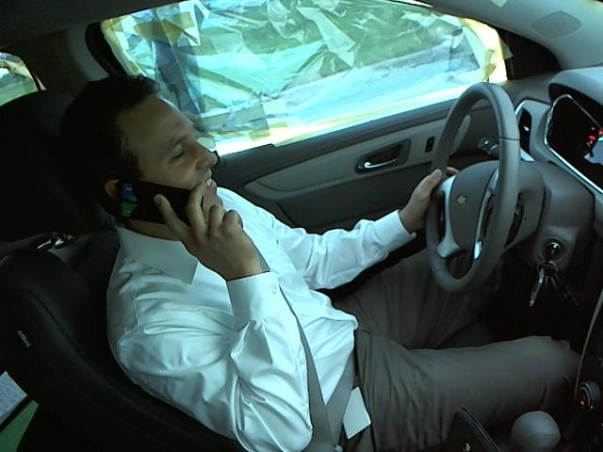
C2
Talking on the Phone

Slide 11
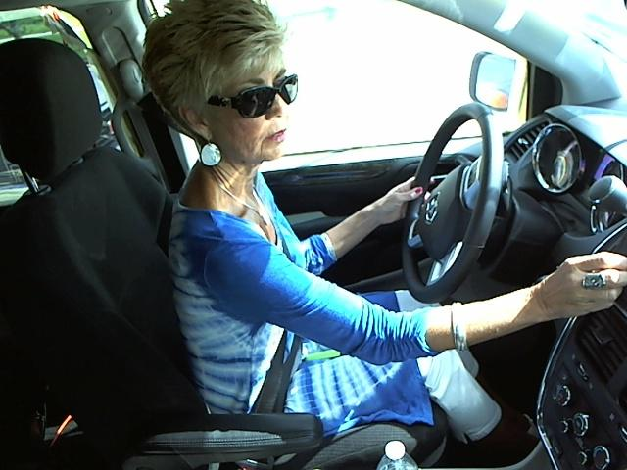
C3
Operating the Radio

Slide 12
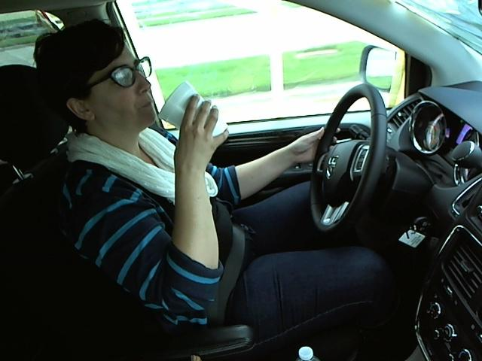
C4
Drinking

Slide 13
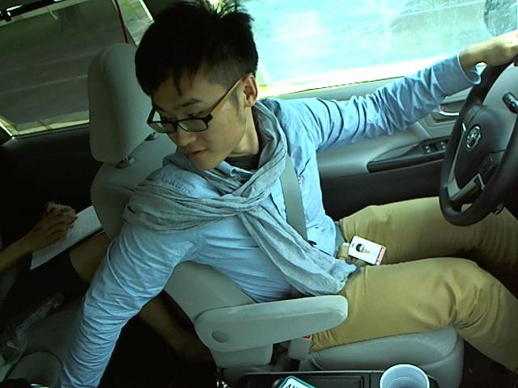
C5
Reaching Behind

Slide 14
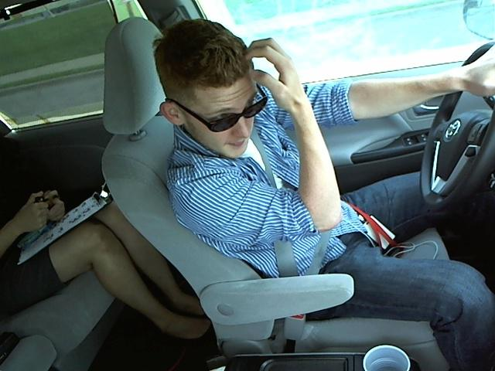
C6
Hair and Makeup

Slide 15
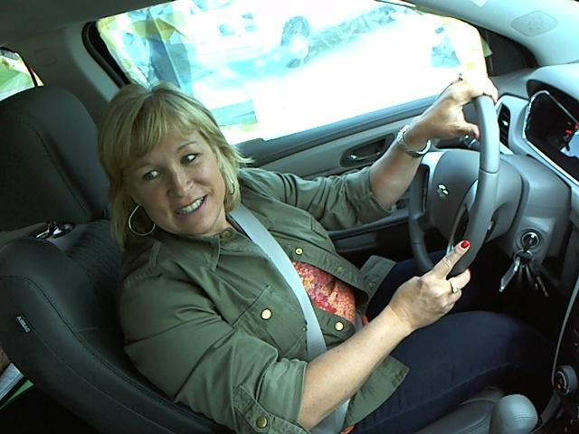
C7
Talking to Passenger

Slide 16
Models
SVM
Logistic Regression
CNN
Multiple CNN Stacking

Slide 17
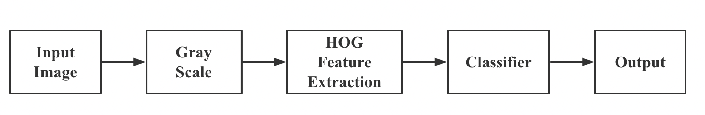
SVM
Logistic Regression
Flow Chart

Slide 18

HOG Feature Extraction
HOG Process
The operation can reduce the effect of light and shadow on the image. This is helpful for the model to identify the driver‘s distracted behavior because the driver’s image will be different according to the road conditions and weather.

Slide 19
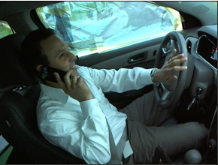
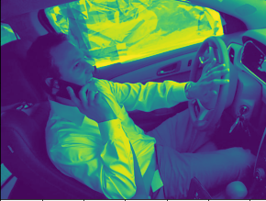
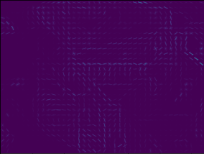
HOG Feature Extraction
Input Image
Gray Scale
Taking on the Phone
SVM/Logistic Regression Model

Slide 20
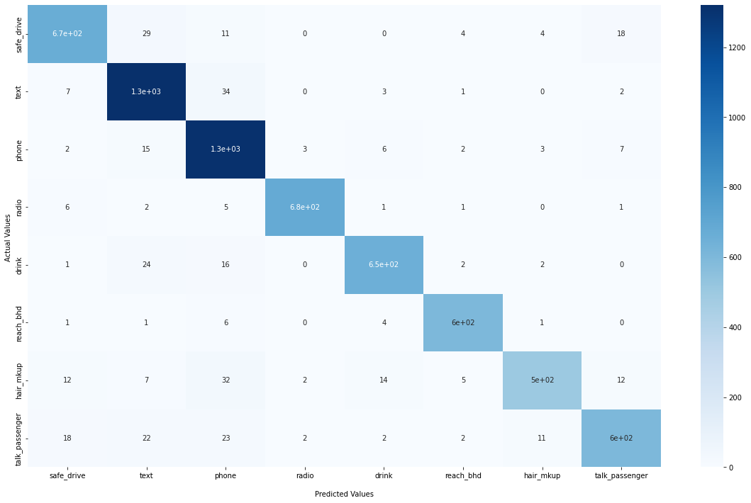
Logistic Regression Result
Set “L1” penalty and C=0.5 to regularize the model
Accuracy: 94.20%
Precision: 93.44%

Slide 21
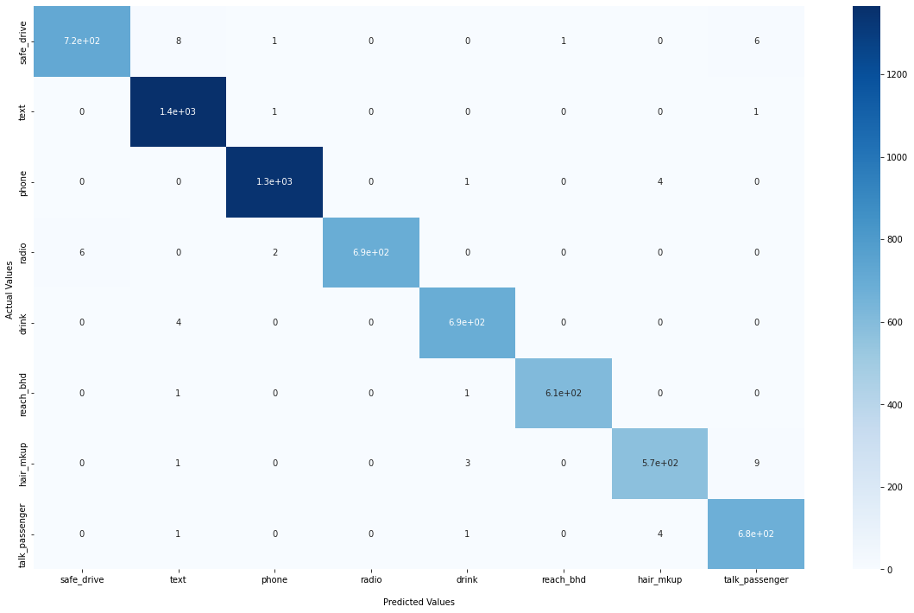
SVM Result
Use “ rbf ” kernel and let penalty coefficient C=1
Accuracy: 99.20%
Precision: 99.17%

Slide 22
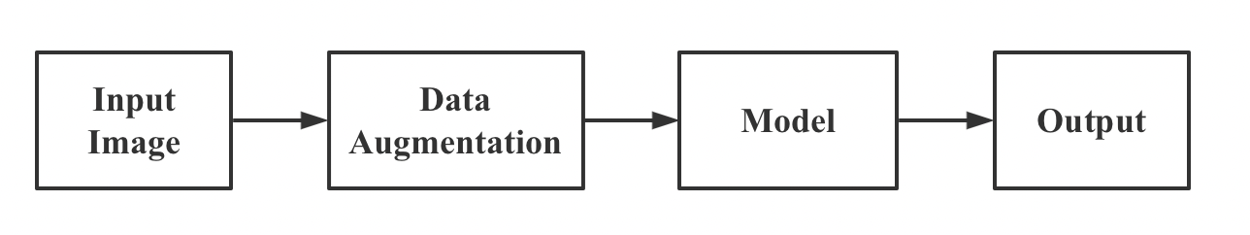
CNN
Multilayer stacking CNN
Flow Chart

Slide 23
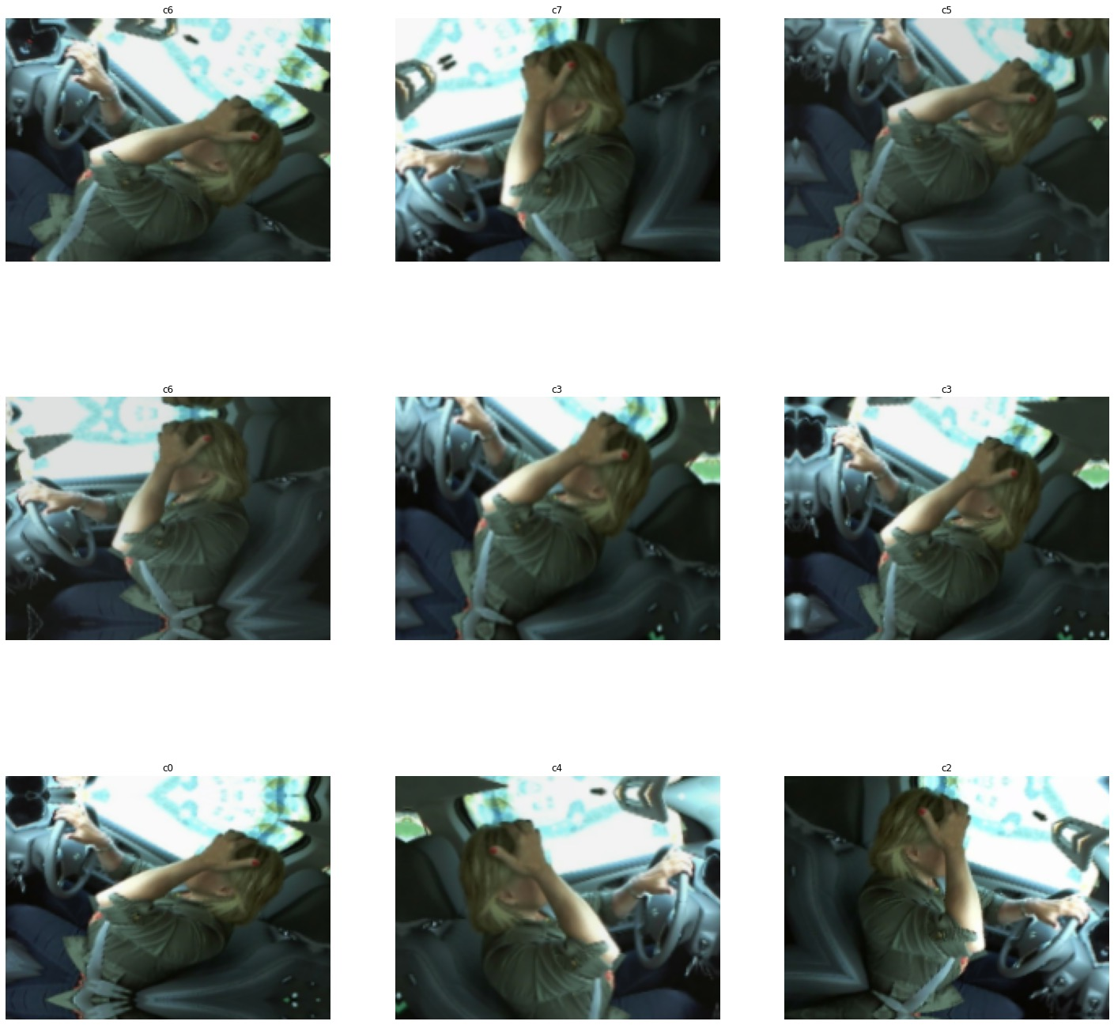
Data Augmentation
Data augmentation is to generate more training data from existing training samples to improve the generalization ability of the model.

Slide 24
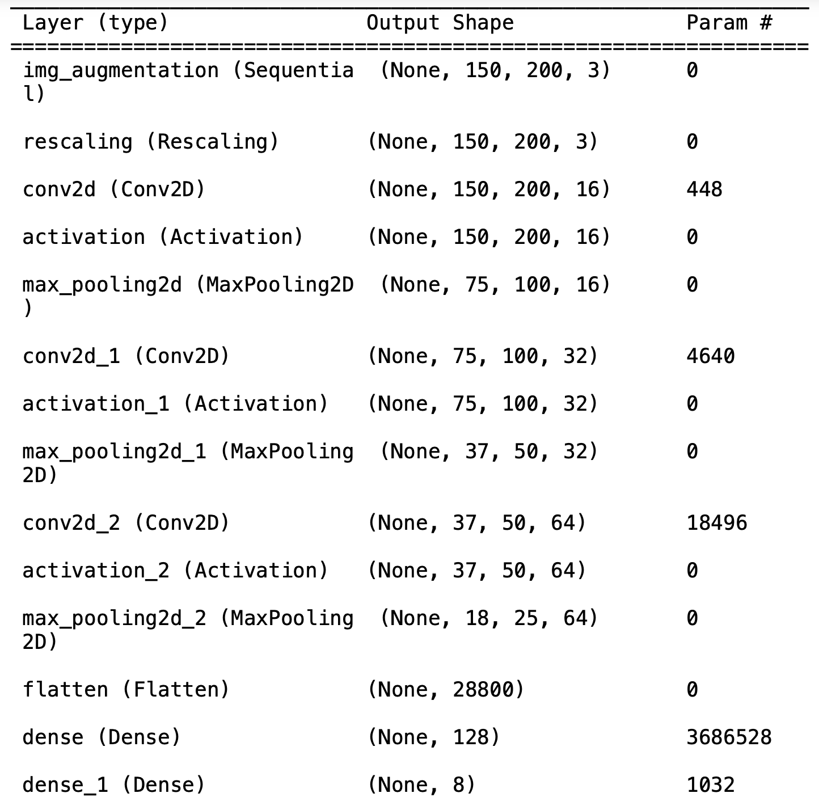
CNN Model Structure

Slide 25
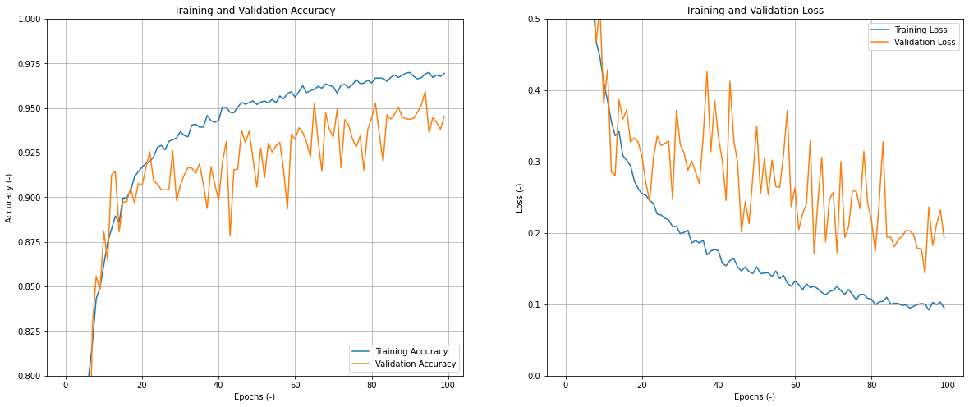
CNN Performance
Epochs: 100

Slide 26
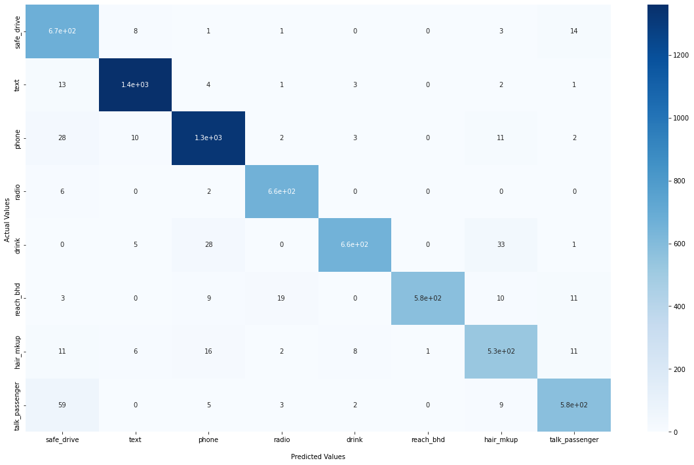
CNN Result
Loss: 0.095
Accuracy: 94.54%
Precision: 84.82%

Slide 27
Improvement
We found that simple CNN models did not perform very well, We think the possible reason is that the model is not complex enough. So,we stack multiple CNNs to make the network structure more complex.

Slide 28
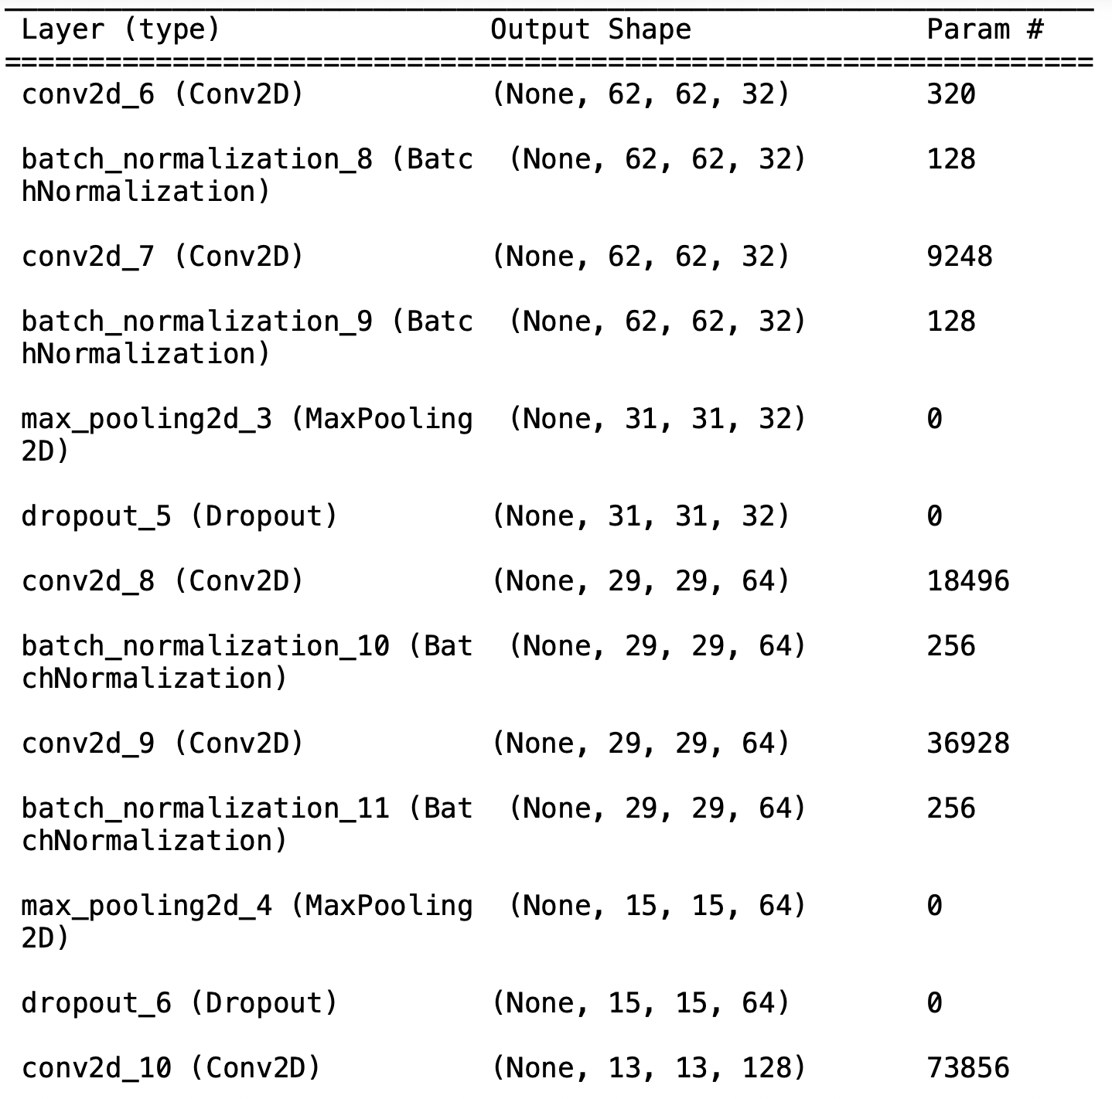
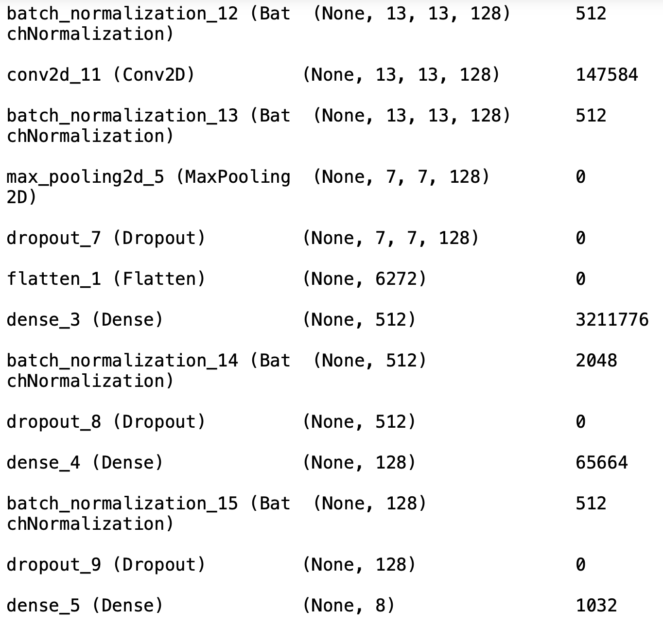
Speed up convergence
Avoid overfitting
Multilayer Stacking CNN

Slide 29
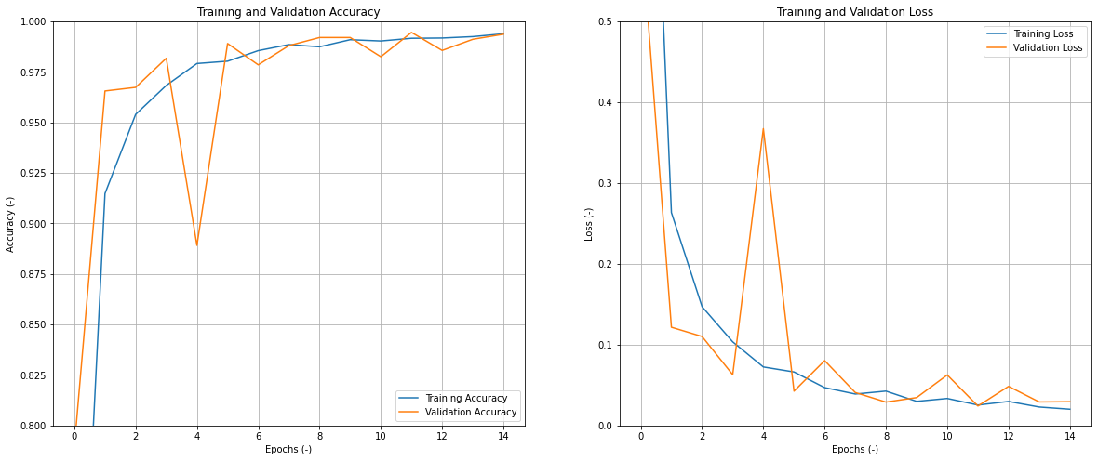
Multilayer Stacking CNN Performance
Epochs: 15

Slide 30
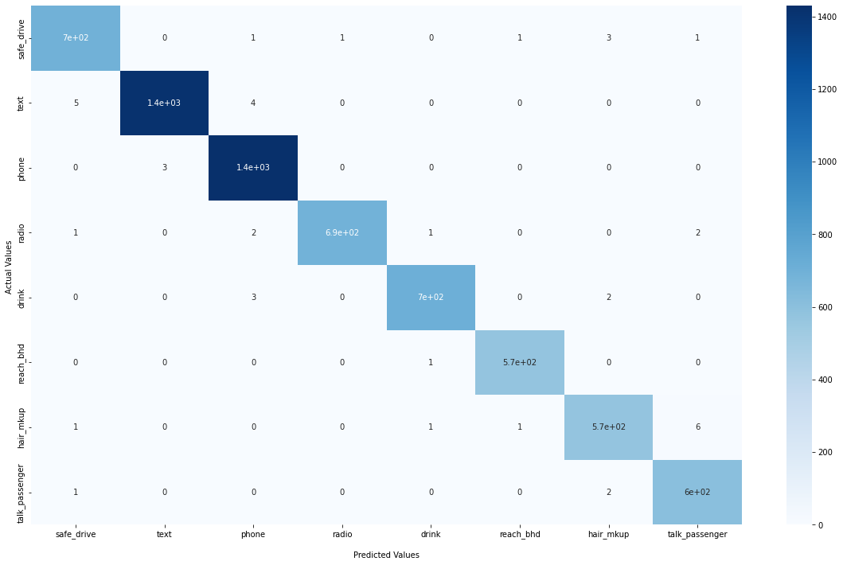
Multilayer stacking CNN Result
Loss: 0.029
Accuracy: 99.36%
Precision: 98.86%

Slide 31

Model Comparison
Model | Accuracy | Precision | Training Speed
Logistic Regression | 94.20% | 93.44% | Normal
SVM | 99.20% | 99.17% | Normal
CNN | 94.54% | 84.82% | Slow
Multilayer stacking CNN | 99.36% | 98.86% | Normal

Slide 32
Part 03
Detection of Drowsiness Driving

Slide 33
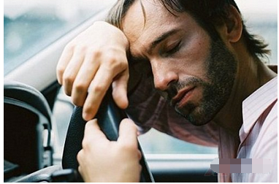
Drowsy Driving
Dangerous driving behavior
Distracted Behaviour
Drowsy Driving
Objective
Determine if a driver is drowsy by identifying two dangerous behaviors

Slide 34
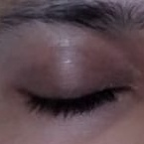
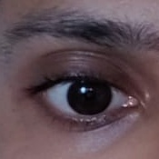
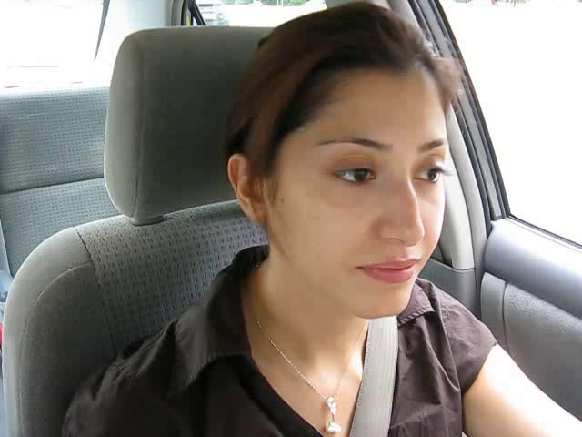
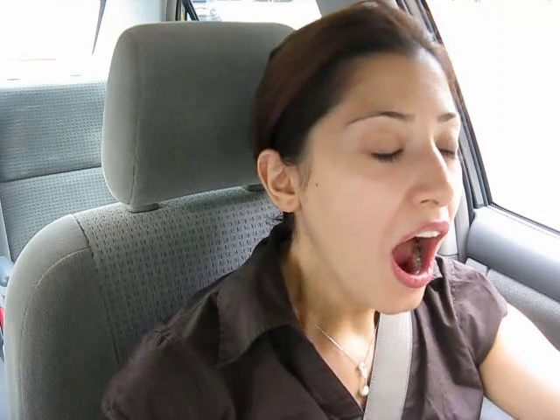
Data Collection
Driving
Closed/Opened eyes
Yawn/no yawn
Eyes closed/open
Yawn/No yawn

Slide 35
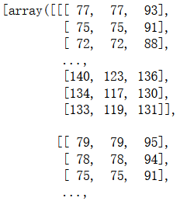
Eyes closed/open fitting
imread
OpenCV
Image
Array
Train / Test = 7:3

Slide 36
Eyes closed/open fitting
Logistic Regression
 | precision | recall | f1-score | support
Closed | 0.96 | 0.95 | 0.95 | 223
Open | 0.94 | 0.96 | 0.95 | 213
macro average | 0.95 | 0.95 | 0.95 | 436
Logistic Regression
Test accuracy: 95.18%

Slide 37
Eyes closed/open fitting
SVM
 | precision | recall | f1-score | support
Closed | 0.95 | 0.93 | 0.94 | 223
Open | 0.93 | 0.94 | 0.94 | 213
macro average | 0.94 | 0.94 | 0.94 | 436
SVM
Test accuracy: 93.81%

Slide 38
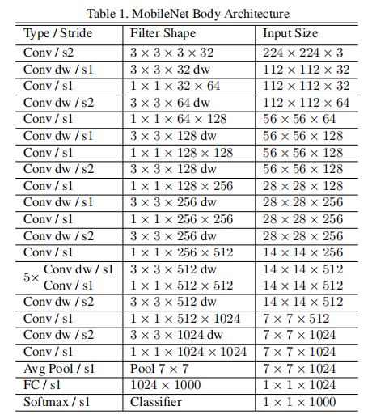
Eyes closed/open fitting
MobileNet
Reduce model size while maintaining model performance while increasing model speed

Slide 39
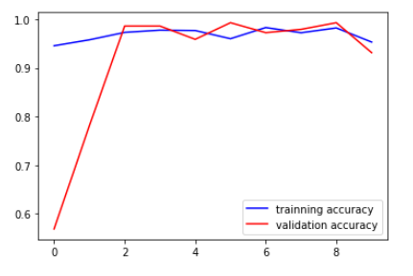
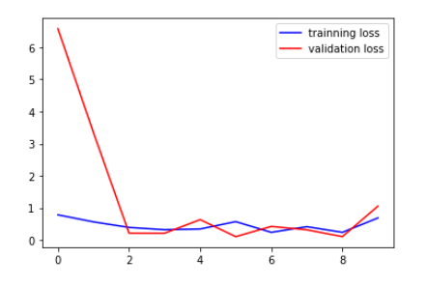
Eyes closed/open fitting
MobileNet
After 10 epochs fitting
Final accuracy: 95.33%

Slide 40
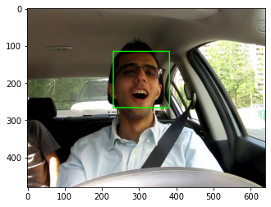
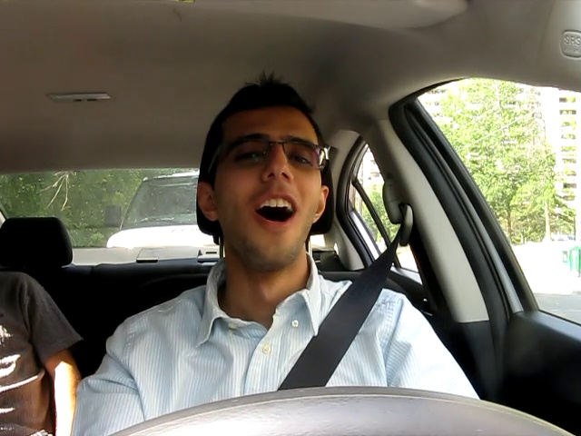
Yawn/No yawn fitting
Face Recognition
detectMultiScale
Input
Face Recognition
Output

Slide 41
Yawn/No yawn fitting
Logistic Regression & SVM
 | precision | recall | f1-score | support
Yawn | 0.88 | 0.82 | 0.85 | 74
No yawn | 0.82 | 0.88 | 0.85 | 68
macro average | 0.85 | 0.85 | 0.85 | 142
 | precision | recall | f1-score | support
Yawn | 0.91 | 0.85 | 0.88 | 74
No yawn | 0.85 | 0.91 | 0.88 | 68
macro average | 0.88 | 0.88 | 0.88 | 142
Logistic Regression
SVM

Slide 42
Yawn/No yawn fitting
Ensemble Learning
XGBoost
LightGBM
RandomForest

Slide 43
Yawn/No yawn fitting
Boosting algorithms
XGBoost
Based on gradient boosting decision tree
Advantages:
Higher accuracy
More flexible
Complexity control
Higher learning rate
Accuracy: 87.13%

Slide 44
Yawn/No yawn fitting
Boosting algorithms
LightGBM
Based on XGBoost
Advantages
Lower time complexity
Lower space complexity
Accuracy: 87.32%

Slide 45
Yawn/No yawn fitting
Bagging algorithms
RandomForest
Bootstrap Aggregating algorithm: Strong classifier algorithm
Advantages
Good performance
Can handle high-dimensional data
Fast training speed
Resistant to overfitting
Accuracy: 85.92%

Slide 46
Yawn/No yawn fitting
Ensemble learning
Ensemble learning:
XGBoost, LightGBM, RandomForest
Learning weight:
XGBoost : LightGBM : RandomForest = 2:3:3
Accuracy: 88.03%

Slide 47
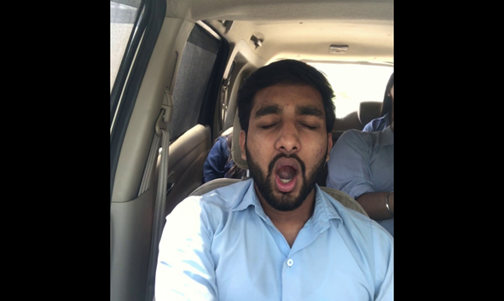
Combining two models
The role of the models
Determine whether the driver is fatigued in 5 consecutive frames.
Example:
Output:
The driver is drowsing!
Tested by two models
Input

Slide 48

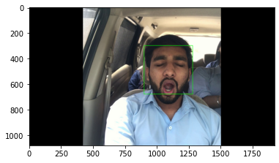
Combining two models
Yawn prediction
Example:
Input
Face Recognition
Output
Model prediction: yawn = True

Slide 49

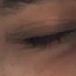
Combine and prediction
Eyes prediction
Example:
Input
Eyes Recognition
Output
Model prediction: closed eyes= True

Slide 50
Combine and prediction
Conditions
Drowsy conditions
In a picture of five consecutive frames of a video
3 frames of pictures with eyes closed
and
This person is yawning

Slide 51
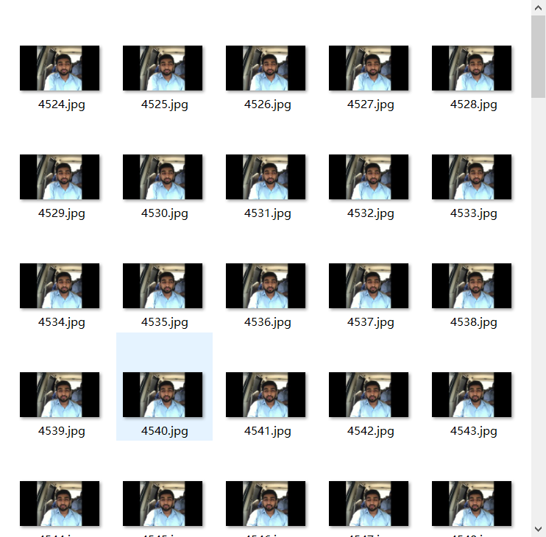

Combine and prediction
Combine
Test set

Slide 52
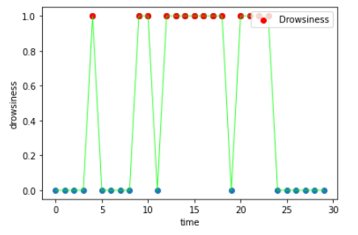
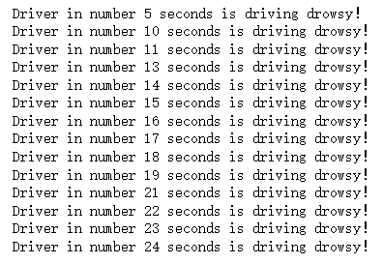
Test Result
Red: Drowsiness
Blue: Not Drowsiness
predict accuracy： 86.6%
recall：91.7%

Slide 53
Part 04
Conclusion

Slide 54
Conclusion
Detection of Distracted Behaviors
Detection of
Drowsy Driving
SVM
Multilayer stacking CNN
Accuracy: 99%
Precision: 99%
Combine with MobileNet and Ensemble Model
Accuracy: 86.6%
Recall: 91.7%

Slide 55
References
1. C. Huang, X. Wang, J. Cao, S. Wang and Y. Zhang, "HCF: A Hybrid CNN Framework for Behavior Detection of Distracted Drivers," in IEEE Access, vol. 8, pp. 109335-109349, 2020, doi: 10.1109/ACCESS.2020.3001159.
2. Dalal, N. , & Triggs, B. . (2005). Histograms of Oriented Gradients for Human Detection. IEEE Computer Society Conference on Computer Vision & Pattern Recognition. IEEE
3. Howard, A. G., Zhu, M., Chen, B., Kalenichenko, D., Wang, W., Weyand, T., ... & Adam, H. (2017). Mobilenets: Efficient convolutional neural networks for mobile vision applications. arXiv preprint arXiv:1704.04861.

Slide 56
References
4. T. Danisman, I. M. Bilasco, C. Djeraba and N. Ihaddadene, "Drowsy driver detection system using eye blink patterns," 2010 International Conference on Machine and Web Intelligence, 2010, pp. 230-233, doi: 10.1109/ICMWI.2010.5648121.
5. Wang JJ, Wang YK, Zhang F, Zhang SW, Dai Y, Yu XD. Real-Time Detection for Eye Closure Feature of Fatigue Driving Based on CNN and SVM. Computer Systems and Applications, 2021, 30(6): 118-126(in Chinese).http://www.c-s-a.org.cn/1003-3254/7968.html.
6. Z. Jie, M. Mahmoud, Q. Stafford-Fraser, P. Robinson, E. Dias and L. Skrypchuk, "Analysis of Yawning Behaviour in Spontaneous Expressions of Drowsy Drivers," 2018 13th IEEE International Conference on Automatic Face & Gesture Recognition (FG 2018), 2018, pp. 571-576, doi: 10.1109/FG.2018.00091.

